Slide 1


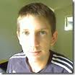
Behaviour-Driven Development with StoryQ Liam McLennan Freelance Web Developer
liam.mclennan@gmail.com hackingon.net @liammclennan

Slide 2
Testing / Quality Assurance
The three ways to maintain release quality:
Automatic testing of all features ever implemented
Manual testing of all features ever implemented
Customer testing of features as they encounter them in production

Slide 3
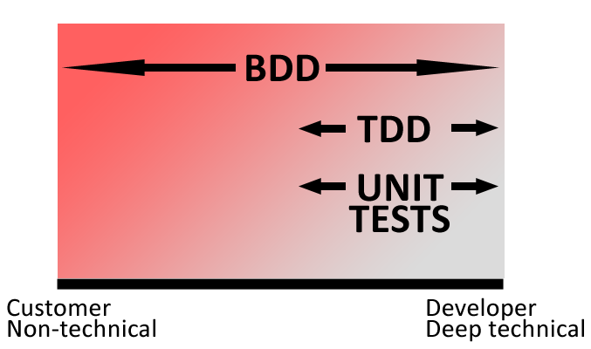
Some Automated Testing Strategies
Unit Tests / Test After
Test First (TDD)
Behaviour-Driven Development
Notes:
Unit test = Implementation verification
TDD = linking verification and design
BDD = linking verification and requirements

Slide 4

“Behaviour-driven development is about implementing an application by describing its behaviour from the perspective of its stakeholders”
Dan North

Slide 5
Features
Tests are written outside-in, using the customer’s language and a simple test grammar.
Tests verify the intended behaviour, not the details of the implementation.

Slide 6
Behaviour-Driven Development Workflow
Write a user story that delivers some value to the user
Define the behaviour using executable scenarios
Implement the behaviour until each scenario passes
Notes:
BDD is outside in.

Slide 7
Hash Functions
“A hash function is any well-defined procedure or mathematical function that converts a large, possibly variable-sized amount of data into a small datum”
Wikipedia
http://en.wikipedia.org/wiki/Hash_function

Slide 8
A String Hasher
Story is Generate a hash of a string
In order to reliably generate a consistent short representation of some text
As a application user
I want to generate a hash of a string
What are the properties of a successful hash?

Slide 9
with scenario Generate a hash of string
given a string "cellar door”
when the hash is generated
then the hash is 32 characters long
and the hash is not equal to the input string
Notes:
Jump to StoryQ Converter
Write first specification
Show report

Slide 10
with scenario Generate a hash repeatably
given a string "A man is rich in proportion to the number of things he can afford to let alone."
when a hash is generated twice
then the first result is equal to the second result

Slide 11
with scenario Generate different hashes
given the strings "cellar door" and "A man is rich in proportion to the number of things he can afford to let alone."
when a hash is generated for each string
then the first result is not equal to the second result

Slide 12
StoryQ
http://storyq.codeplex.com/

Slide 13
Meet the competition
MSPec http://github.com/machine/machine.specifications
Specflow http://www.specflow.org/

Slide 14
Still Don’t Get BDD?
http://dannorth.net/introducing-bdd
http://www.code-magazine.com/article.aspx?quickid=0805061

